Slide 1
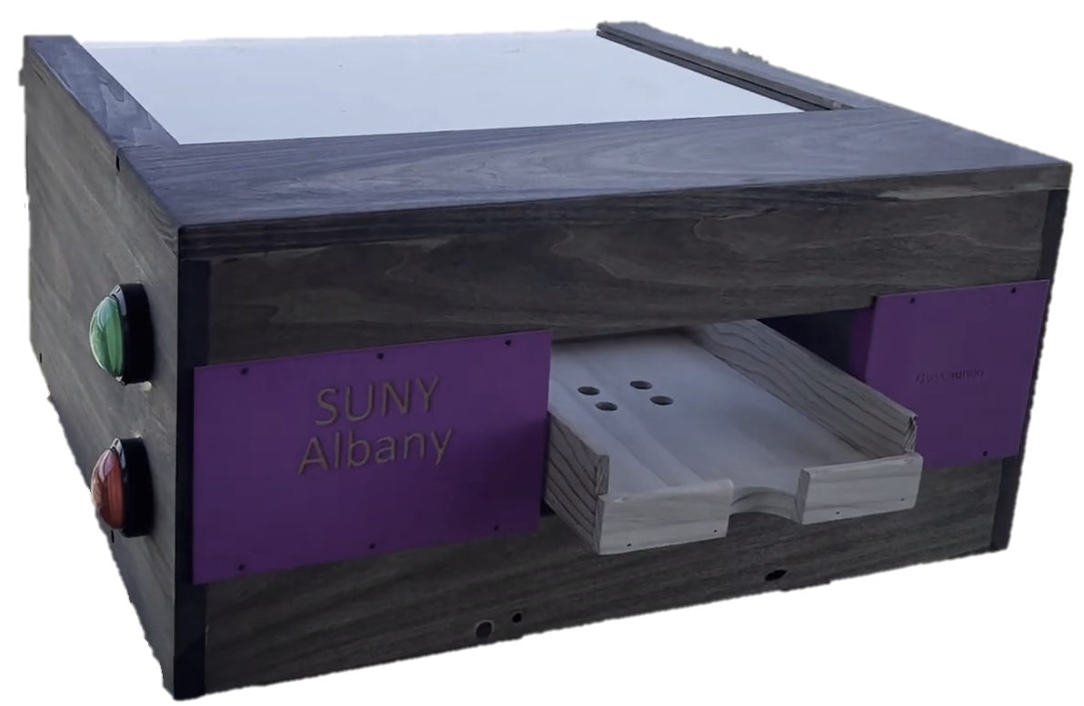
Automated Ream Opener
Mazin Chater
Youssef Jalwaj-Soubai
Abdullah Qureshi

Slide 2
Overview
01
02
03
04
05
06
The Issue
Requirements
Solution
Previous limitations
How requirements influenced the design
Core functionality & how our design addresses the issue
Features
Impact
Wrap Up
A closer look at key components & code functionality
How our solution will be used
Slideshow & Q/A

Slide 3
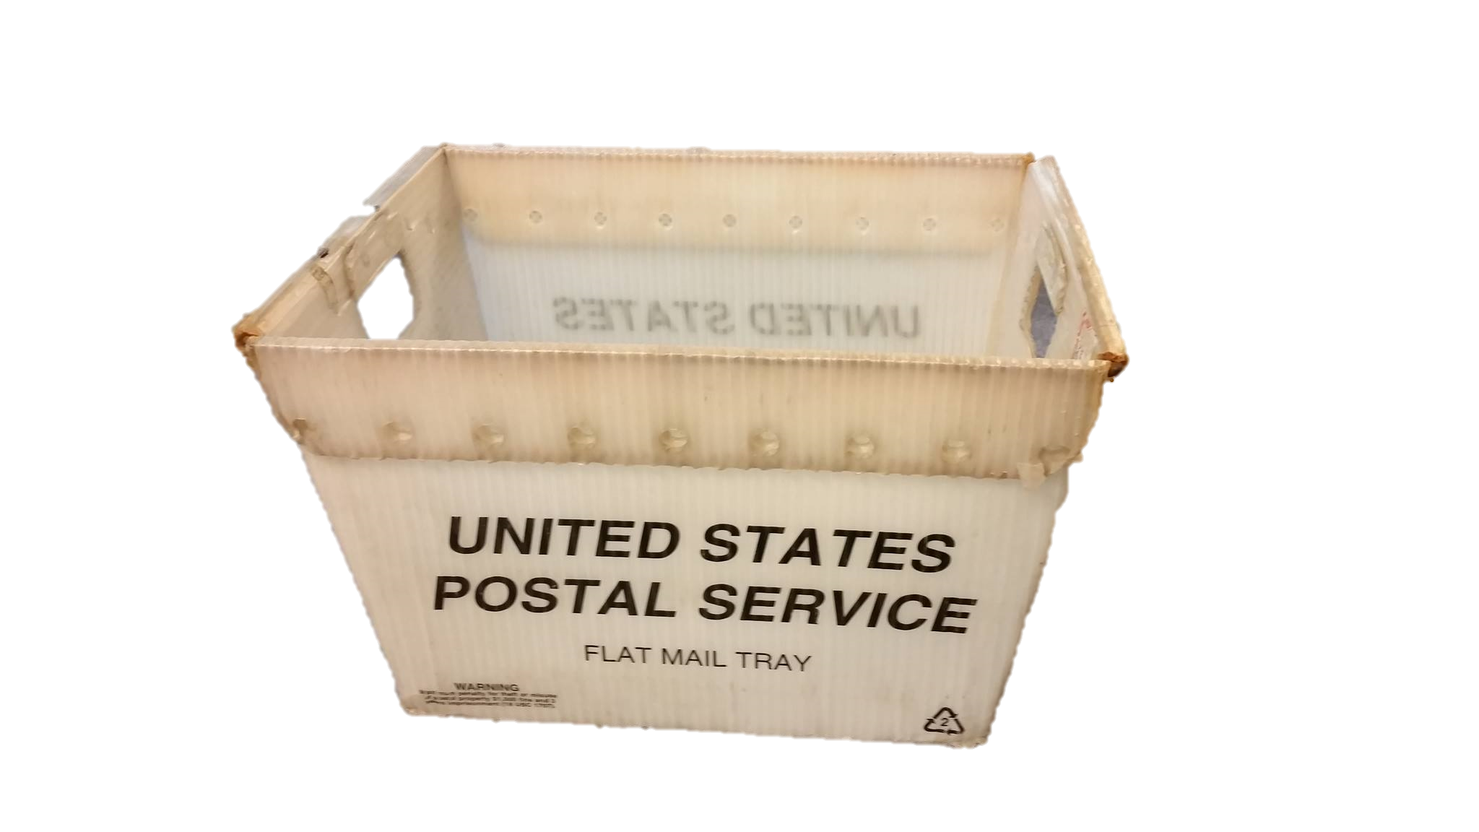
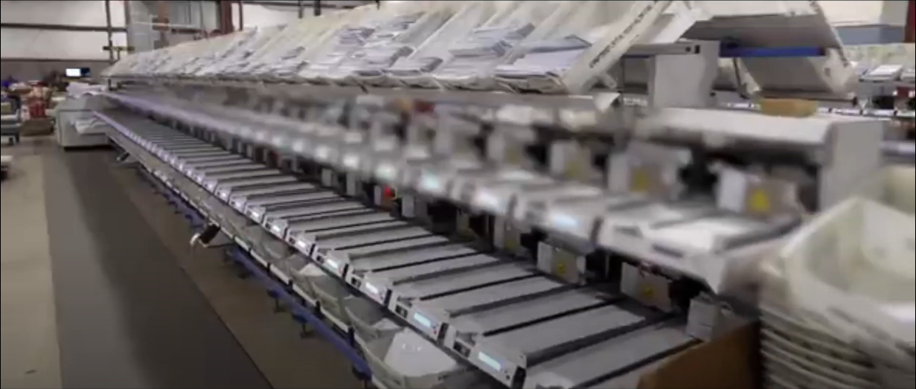
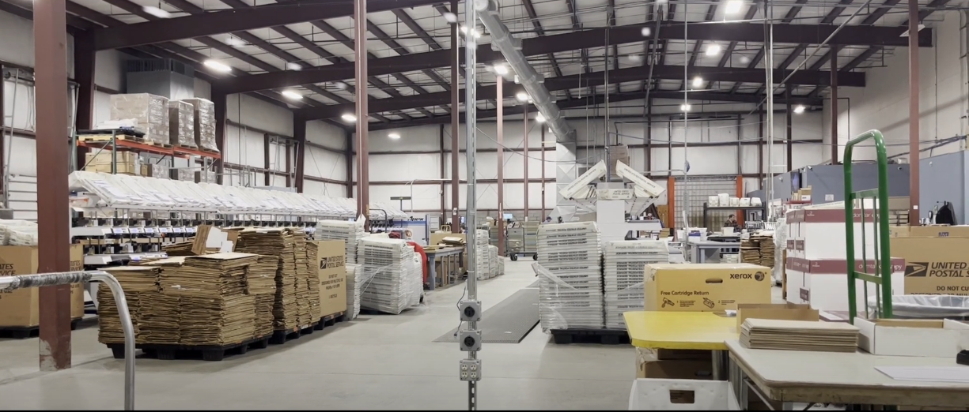
Problem
The Center for Disability Services Mailing Center processes an enormous amount of paper daily.
They use about 50,000-100,000 paper sheets per day.

Slide 4
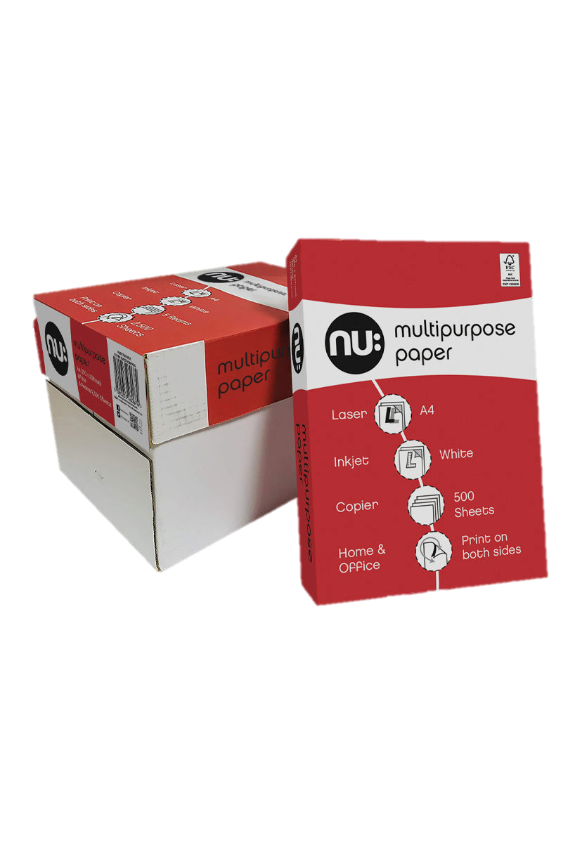
Problem
To get the paper, it must be manually opened from reams containing 500 sheets each.
This translates to about 100-200 reams per day.

Slide 5
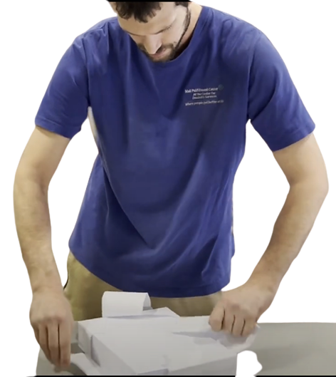
Problem
For disabled individuals, opening large volumes of reams presents many issues:
Damages internal paper
Paper cuts
Needs supervision

Slide 6

System Requirements
Safety
Functionality
The developed system must be safe to use
Fully functional, reliable, and adjustable

Slide 7


System Requirements
Accessibility
Timing
Simple and easy to use
Considered a bonus to balance efficiency with the worker’s sense of contribution

Slide 8
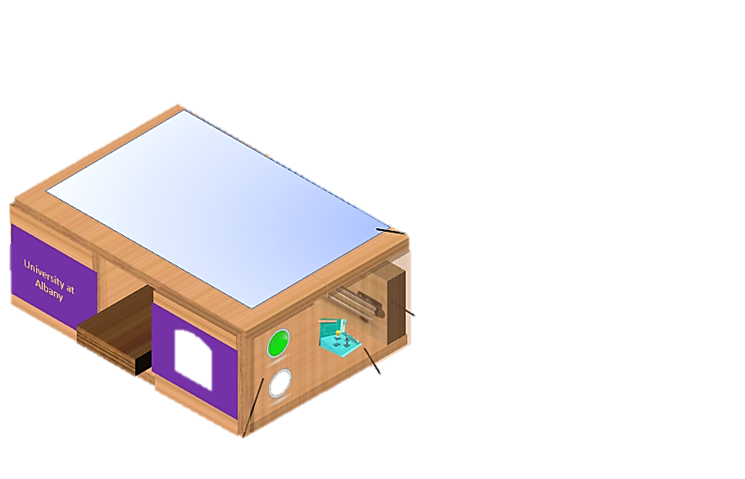
Solution
How does it work?

Slide 9
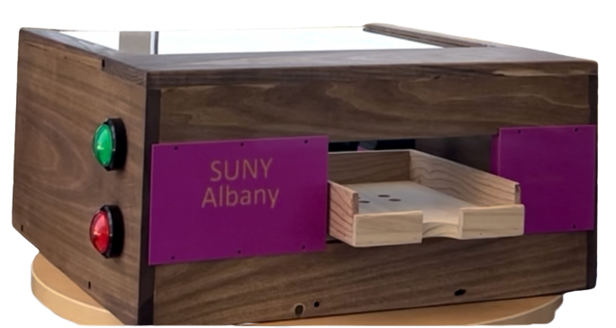
Function
1) Insert Wrapped Ream Into Tray
2) Green Button Initiates Operation
3) Blades Slice Outside Layer
4) Unsealed Ream Returns

Slide 10
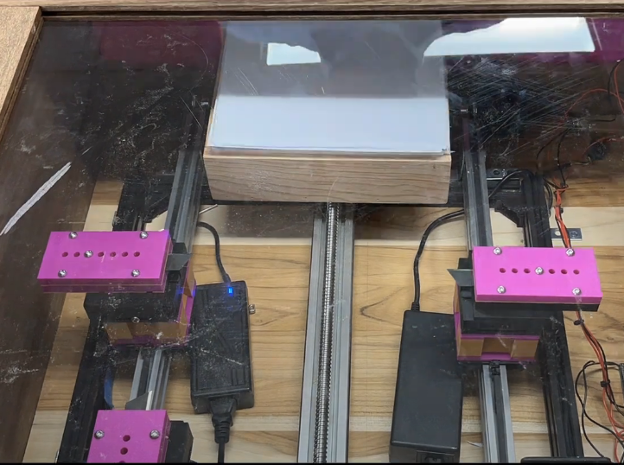
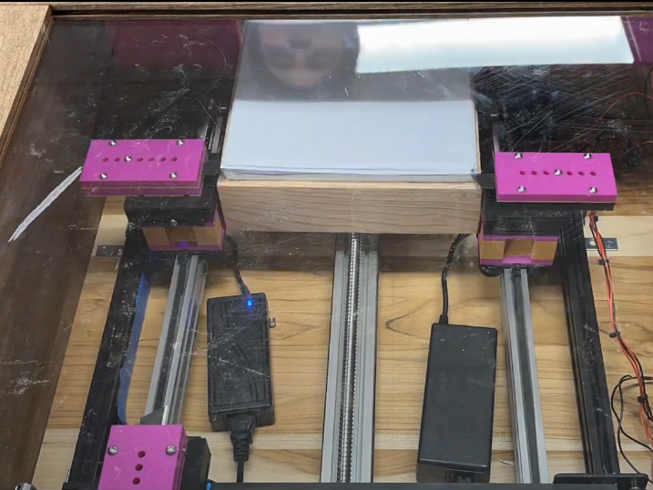
Safety Features
Emergency Stop
Blade Position
If any issues arise, an emergency stop button ensures operations halt
Analog blade holders ensure the blades are exposed to a minimum
Cart Position
Button Position
The carts are set in the back of the machine and only move towards the ream upon the start sequence
The buttons are on the side of the machine to prevent any accidental presses

Slide 11
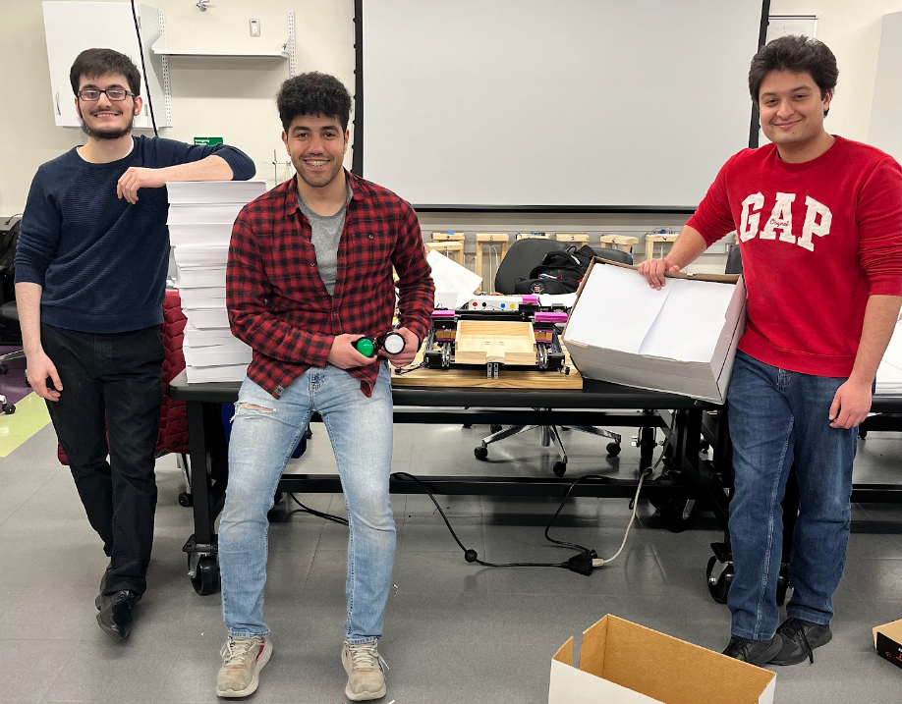
Key Improvements
→ Disabled workers can independently use the device
→ Design is reliable:
200+ reams have been opened with a ~95% success rate
→ Takes only a press of a button & 30 seconds to open a ream

Slide 12
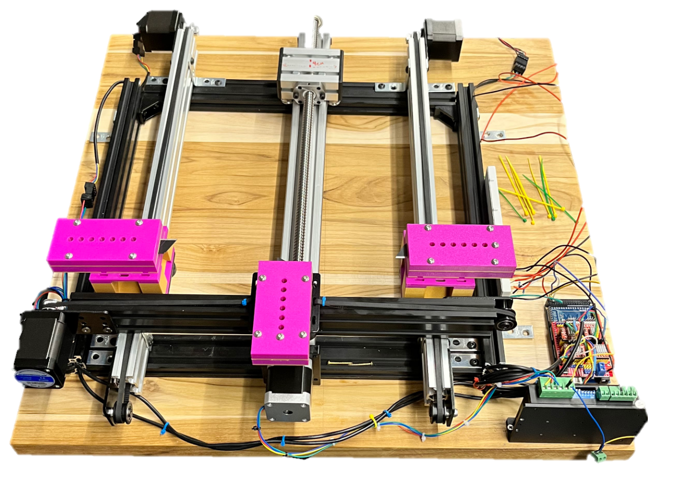
Key Components
NEMA 17 Motors
Base for Tray
Threaded Rod
Analog Blade Holders
NEMA 23 Motor
Arduino, CNC Shield, DM542T

Slide 13
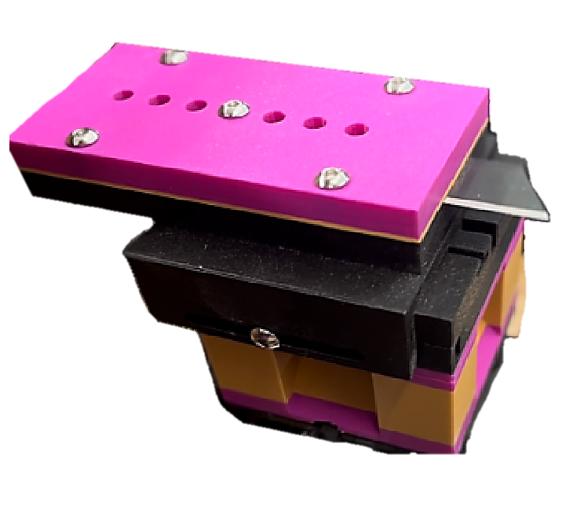
Analog Blade Holders
→ Allows blades to be just barely exposed
→ Blades are easily interchangeable
→ Blades can be adjusted to hit the outside layer of paper without damaging inner contents

Slide 14
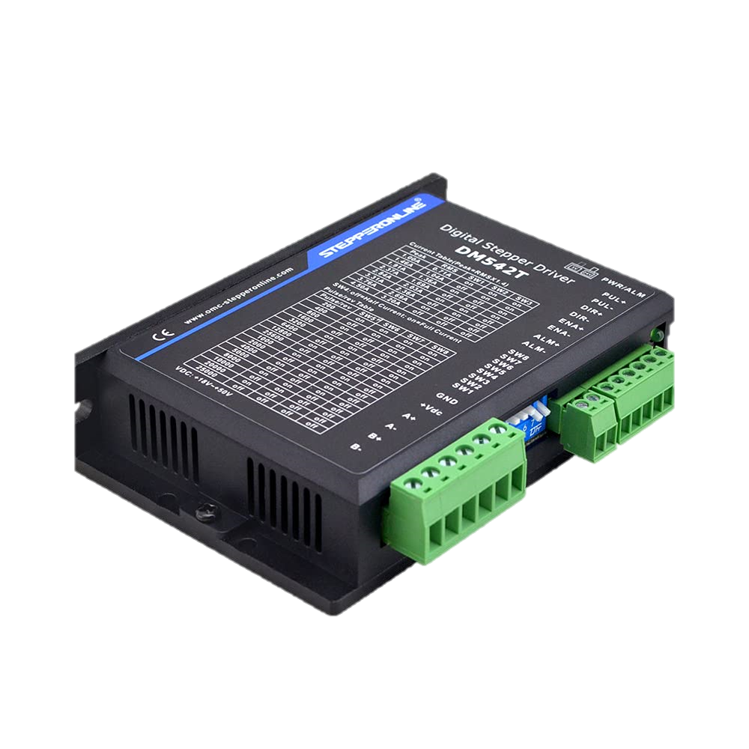
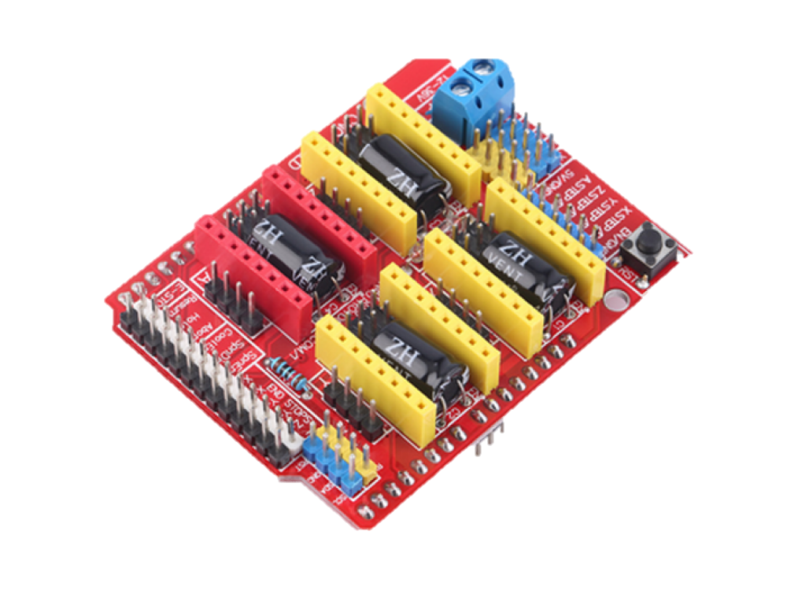
DM542T & CNC Shield
Drives top NEMA 23 stepper motor, threaded rod stepper motor, and the two side NEMA 17 motors.

Slide 15
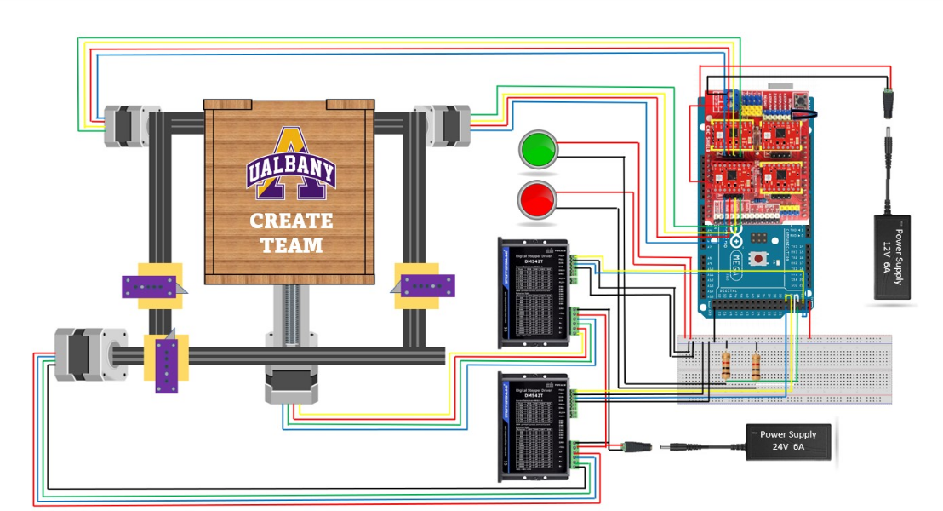
Circuitry

Slide 16

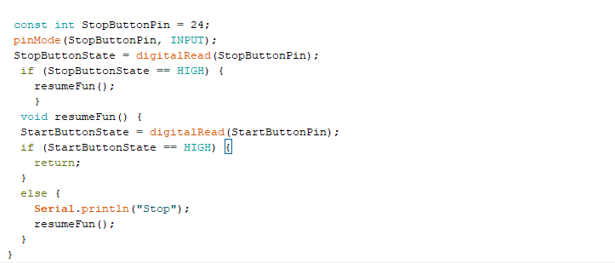

Code

Slide 17
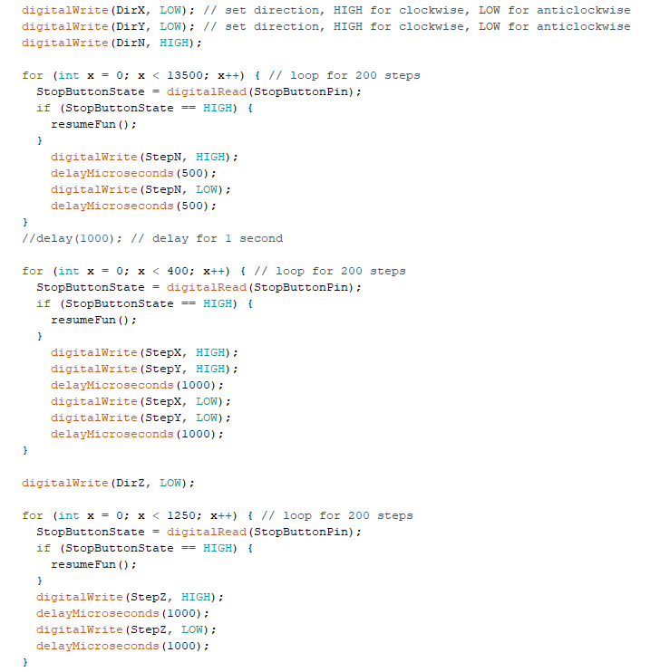
Code

Slide 18
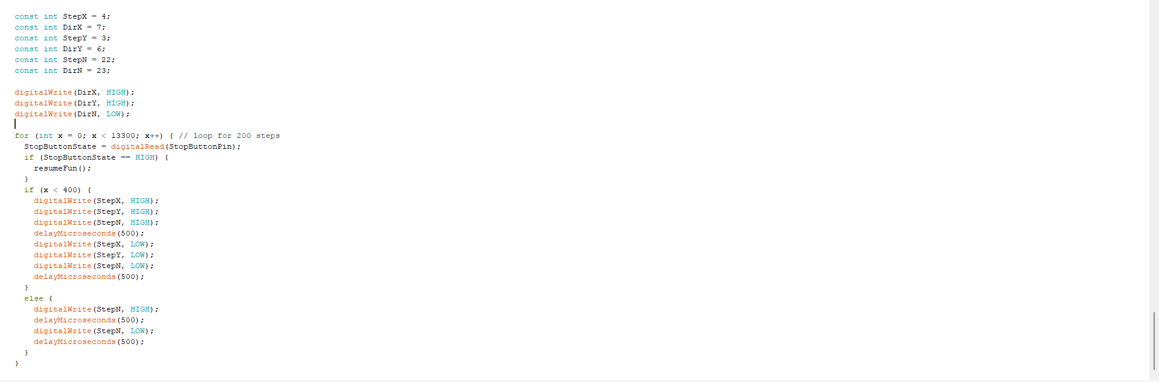
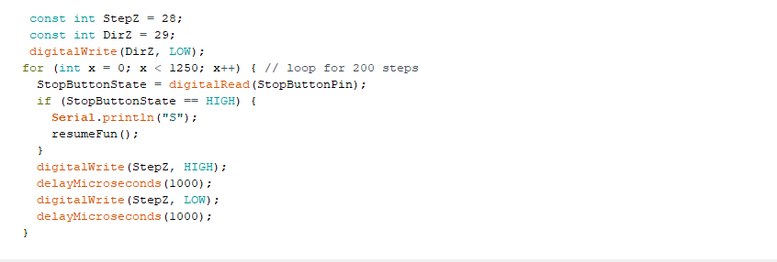
Code

Slide 19
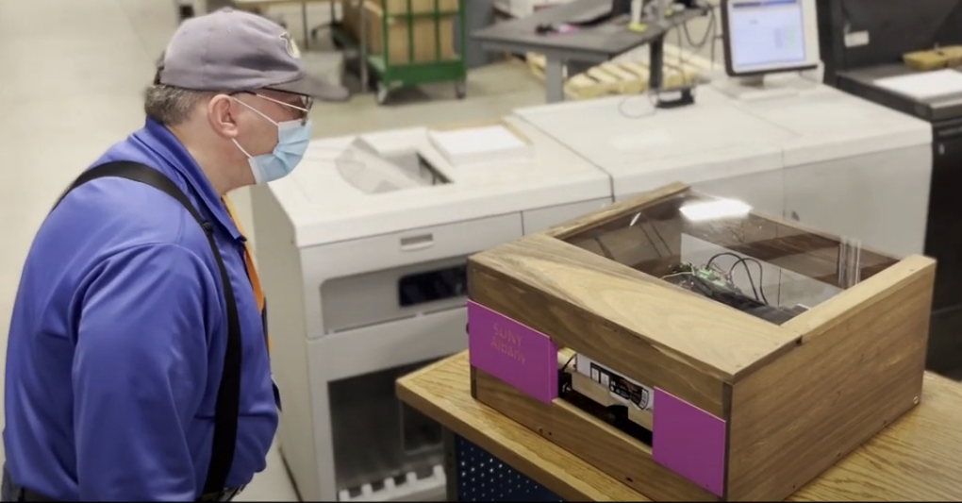
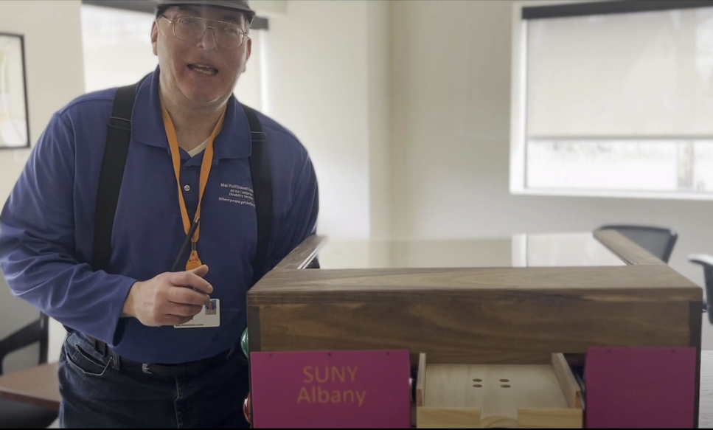
Impact
The Center for Disability Services Mailing Center has expressed interest in hiring full-time disabled staff to use the machine
Current disabled employees have also been using it at the facility

Slide 20
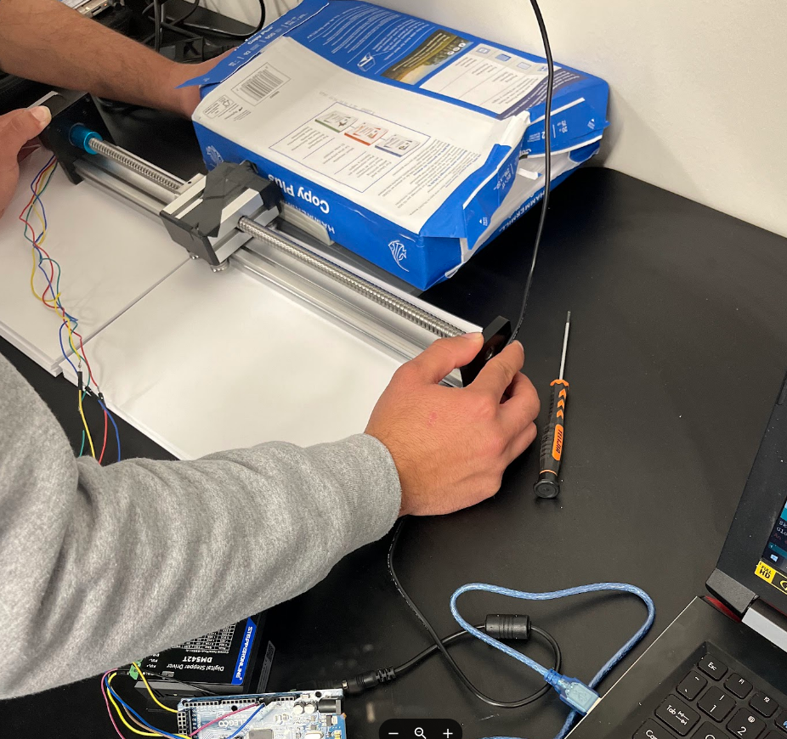
September

Slide 21
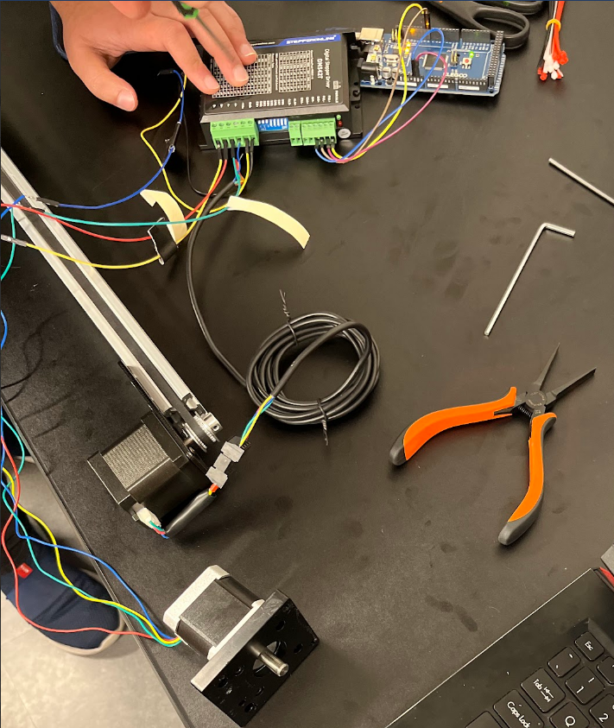
October

Slide 22
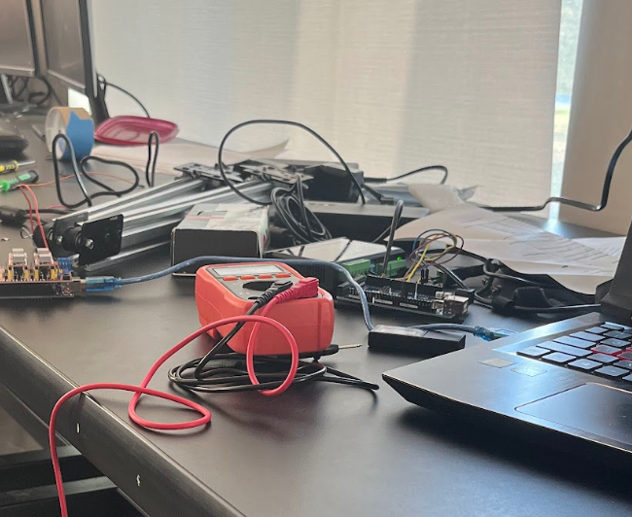
November

Slide 23
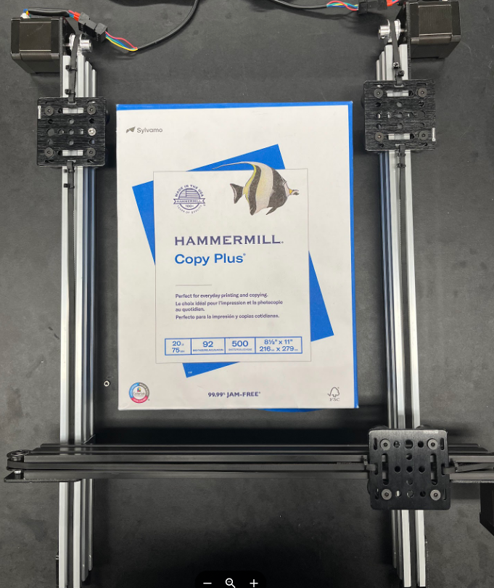
December

Slide 24
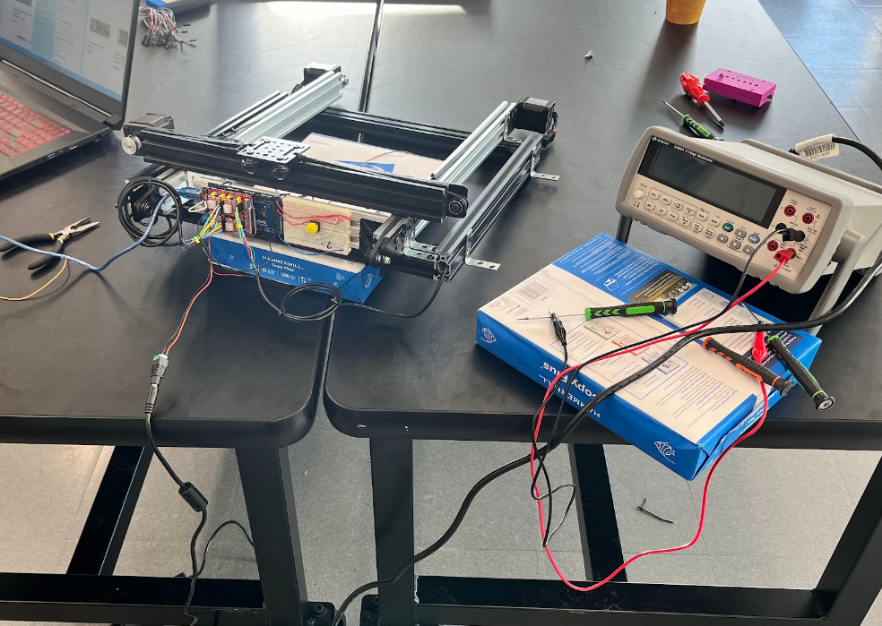
January

Slide 25
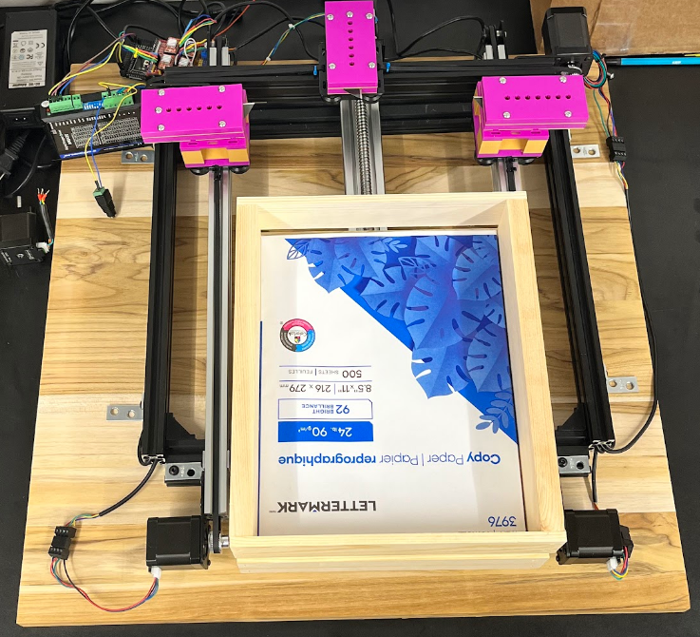
February

Slide 26
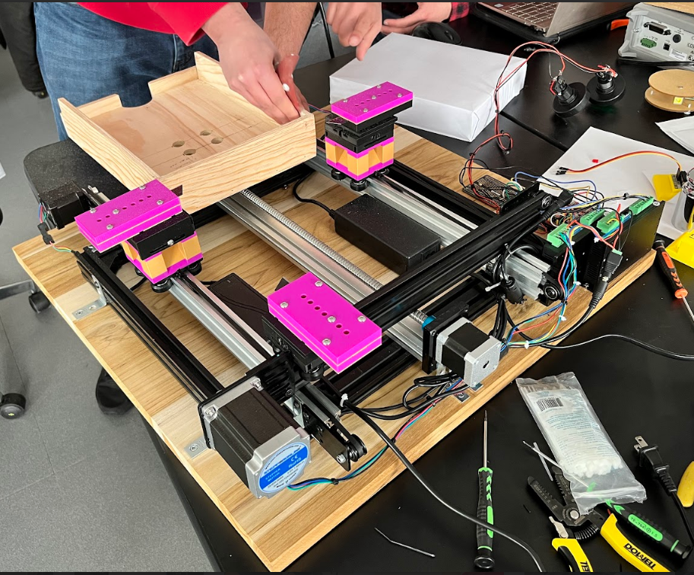
March

Slide 27

April

Slide 28
Thank you
Any questions?

